Slide 1
Secondary Hyperparathyroidism
in
Chronic Kidney Disease
พ. เจริญ เกียรติวัชรชัย
24 มีค 2568: 16:00 น

Slide 2
เนื้อหา:
นิยาม
กลไกการเกิด
การรักษาทางยา
การทำ parathyroidectomy

Slide 3

SHPT: definition
SHPT is the medical condition of excessive secretion of PTH by the parathyroid glands in response to hypocalcemia, with resultant hyperplasia of these glands.
This disorder is primarily seen in patients with CKD.

Slide 4
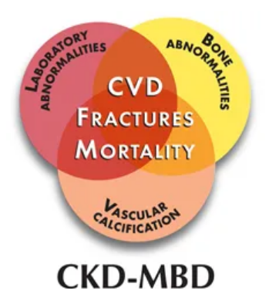
CKD-Mineral Bone Disorder
: SHPT

Slide 5
CKD-MBD: definition
A systemic disorder of mineral and bone metabolism due to CKD manifested by either one or a combination of the following:
(a) abnormalities of Ca, PO₄, PTH, or vitamin D metabolism;
(b) abnormalities in bone turnover, mineralization, volume, linear growth, or strength; or
(c) vascular or other soft tissue calcification
KDIGO 2006

Slide 6
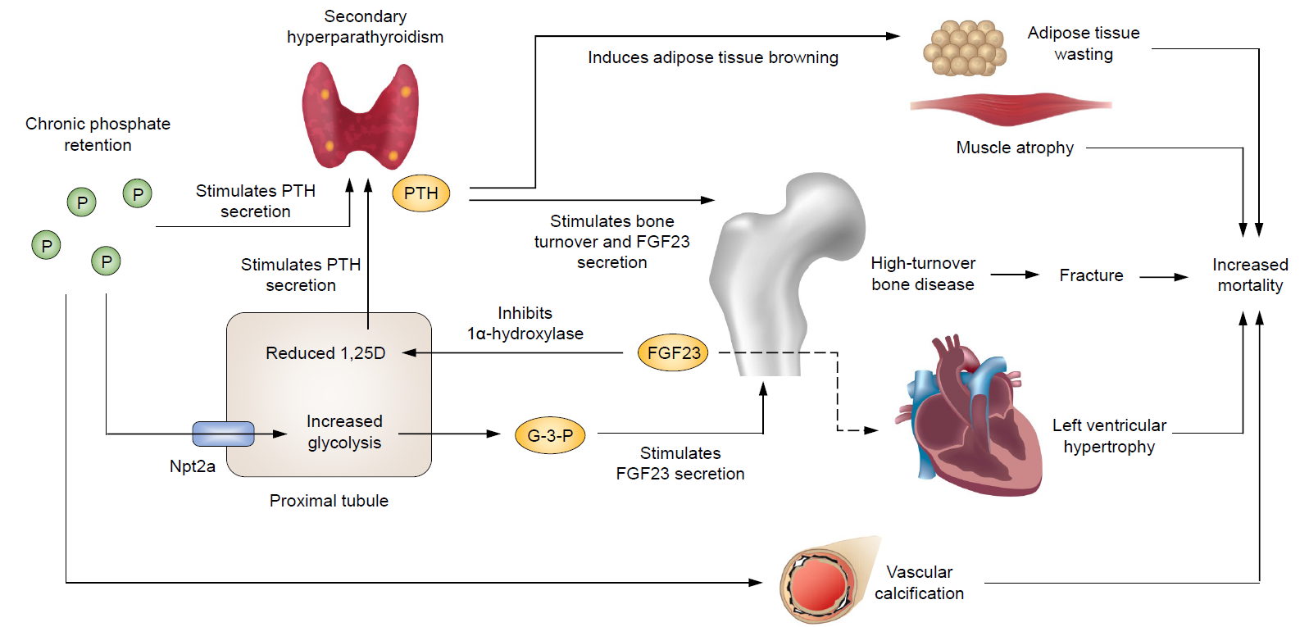
Pathogenesis of CKD-MBD
HypoCa
2024 Korean Endocrine Society

Slide 7
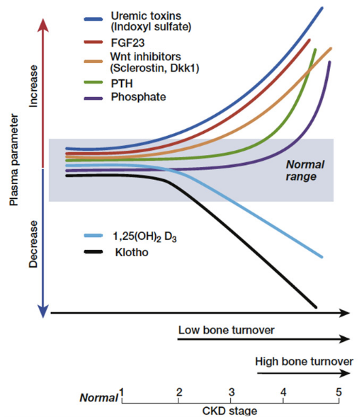
Notes:
Fgf เพิ่มก่อน po4 , pth

Slide 8
SHPT in CKD due to
Phosphate Retention: “trade-off hypothesis”
Calcium Deficiency
Inhibition of Calcitriol Synthesis
Fibroblast Growth Factor 23 (FGF23) and Klotho***
Reduced expression of CaSRs, VDRs, and FGF receptors in the PTH glands
National Library of Medicine 2025

Slide 9
SHPT : Characterised by
Hypocalcaemia
Hyperphosphataemia
Elevated FGF-23
Reduced 1, 25(OH)₂ D₃
HIGH PTH**
National Library of Medicine 2025

Slide 10
Therapeutic strategies for SHPT (1)
Clinical Medicine 24 (2024)

Slide 11
Therapeutic strategies for SHPT (2)
The first step for the patients diagnosed with SHPT is evaluation and correction of the modifiable factors including hyperPO₄, hypoCa and vitamin D deficiency.
Clinical Medicine 24 (2024)

Slide 12
Treatment of SHPT
Options of medical Rx should take into account plasma biochemistry, CKD stage, and x-ray findings, and if available also the dimensions of the largest PT glands, as assessed by US.
A gland diameter of = or > 5-10 mm is considered as being indicative of autonomous growth, which often is resistant to medical Rx
National Library of Medicine 2025

Slide 13
HD Patients : recommended targets of therapy:
PO₄ typically targeted to be between 3.5 and 5.5 mg/dL
Ca ideally maintained below 9.5 mg/dL
PTH at less than 2 to 9 times the upper limit for the assay.
National Library of Medicine 2024

Slide 14
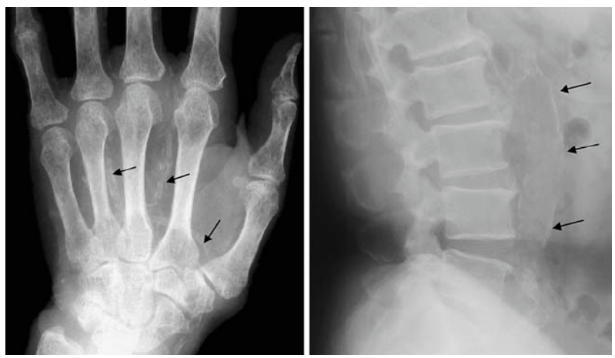
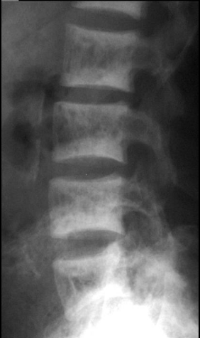
Vascular Calcification & Rugger-Jersey Spine

Slide 15
Treatment of SHPT
To control hyperparathyroidism, it is important to avoid both hypocalcemia and hypercalcemia, and to reduce or correct hyperphosphatemia.
National Library of Medicine 2025

Slide 16
การคุมอาหารเพื่อป้องกัน PO₄ สูง
dietary PO₄ intake should be limited to 800 mg /day
Dietary P (mg) = 78 + 11.8 x protein intake (grams)
ฟอสฟอรัสในอาหารแบ่งเป็น
  อาหารธรรมชาติ (organic phosphorus)
  สารสังเคราะห์ (inorganic phosphorus)

Slide 17
Organic phosphorus
อาหารที่มีโปรตีนสูงจะมี PO₄ สูง
ดูดซึม 40-60%

Slide 18
Inorganic phosphorus
พบมากในสารปรุงแต่งอาหารหรือสารกันบูด
ดูดซึมมากกว่า 90%

Slide 19
PO₄ Binders (1)
The binding ability is limited to approximately 200–300 mg of phosphate daily
The use of Al-containing PO₄ binders is nowadays avoided
Int. J. Mol. Sci. 2022

Slide 20
PO₄ Binders (2)
If needed, a combination of 2 can be used (level B).
Calcium-based binders should be avoided when Ca is >
10.5 mg/dL (level A).
Elemental Ca provided by the Ca-based PO₄ binders should not exceed 1500 mg/day (level B).
Am Board Fam Med 2009

Slide 21
Ca-containing PO₄ Binders
should be given, preferentially during or at the end of PO₄-rich meals, to patients with CKD and uncontrolled hyperphosphatemia who have no hypercalcemia or radiological evidence of marked soft tissue calcifications.
National Library of Medicine 2025

Slide 22
Calcium carbonate
Form, strength | Chewable tablets, 500 mg elemental calcium
Initial dose | 1x 3 a day with meals
Maximum dose | 1 x 3 a day with meals
Disadvantages | Hypercalcaemia, large doses required to be effective, possible vascular calcification Adynamic bone disease
Aust Prescr 2017;40:9–14

Slide 23
Aluminium hydroxide
Form, strength | 600 mg tablets
Initial dose | 1 x 3 a day with meals
Maximum dose | 2 x 3 a day with meals
Disadvantages | No safe dose established, significant AE (e.g. potential CNS toxicity, microcytic anaemia, osteomalacia, GI upset), requires regular monitoring of serum aluminium
Aust Prescr 2017;40:9–14

Slide 24
Lanthanum carbonate
Form, strength | 500 mg, 750 mg, 1000 mg chewable tablets
Initial dose | 1 x 3 a day with meals
Maximum dose | 1000 mg 3 times a day with meals
Disadvantages | Expensive (500 mg 74 baht/tab), GI adverse effects, Uncertain long-term effects
Aust Prescr 2017;40:9–14

Slide 25
Sevelamer hydrochloride
Form, strength | 800 mg tablets
Initial dose | 1–3 tablets a day with meals
Maximum dose | 0.3 g/kg/day (bw 50 kg max = 18 tab)
Disadvantages | Expensive (Sevelamer carbonate 800 mg 56 baht/tab), high pill burden, GI adverse effects (bloating)
Aust Prescr 2017;40:9–14

Slide 26
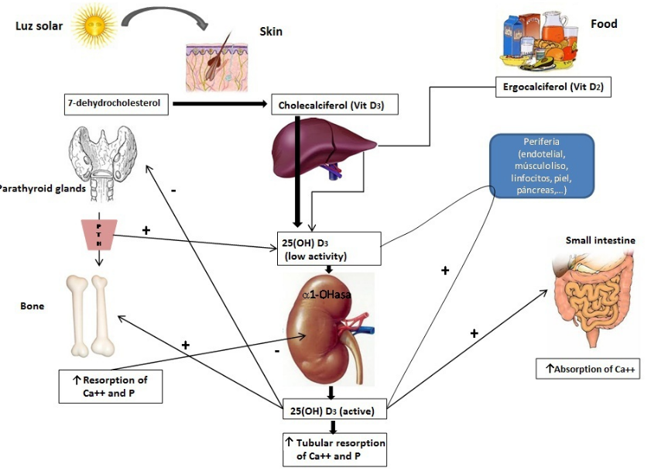
Vitamin D receptor activator (VDRA) :

Slide 27
Treatment of SHPT with Native Vit-D
Native vit-D may lead to improved control of SHPT in patients not yet on dialysis and in those treated by dialysis but no beneficial effect has been observed in a subsequent meta-analysis.
Most importantly, randomized controlled trials with native vit-D have not been performed so far to evaluate hard clinical outcomes of patients with CKD.
National Library of Medicine 2025

Slide 28
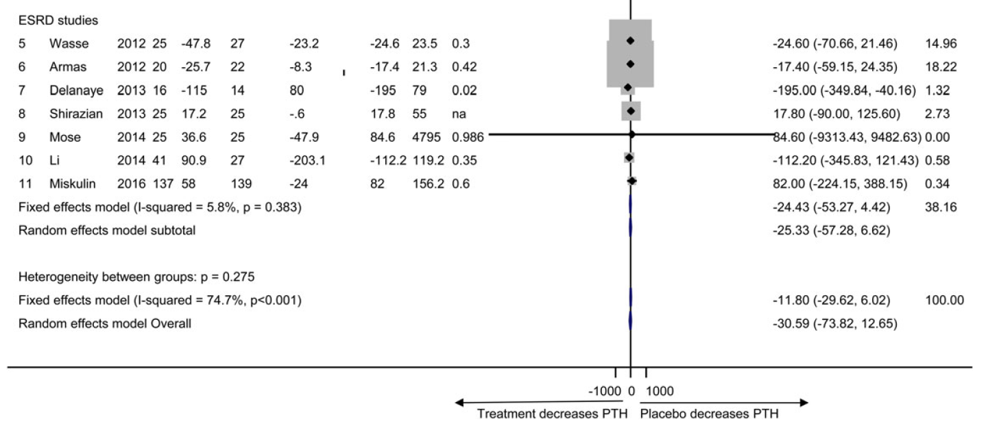
Rx of SHPT: native Vit-d vs Placebo
Nephrol Dial Transplant (2016) 31:

Slide 29
VDRA:
Calcitriol or vitamin D analogs are typically initiated at a low dose (0.25 μg, 3 times a week).
Response to treatment is usually observed within the first 3 to 6 months;
dosage adjustments can be made at 4- to 8-week intervals if necessary
Clinical Medicine 24 (2024)

Slide 30
VDRA: limitations (1)
Reduced expression of VDRs in parathyroid gland hyperplasia may hinder PTH regulation by VDRAs
cause hyperCa and hyperPO₄, adynamic bone disease and increasing vascular calcification risk
Clinical Medicine 24 (2024)

Slide 31
VDRA: limitations (2)
Calcitriol or synthetic vitamin D analogs are discontinued or administered at a low dose if phosphate levels exceed 5.5 mg/dL or calcium levels above 10.2 mg/dL
Clinical Medicine 24 (2024)

Slide 32
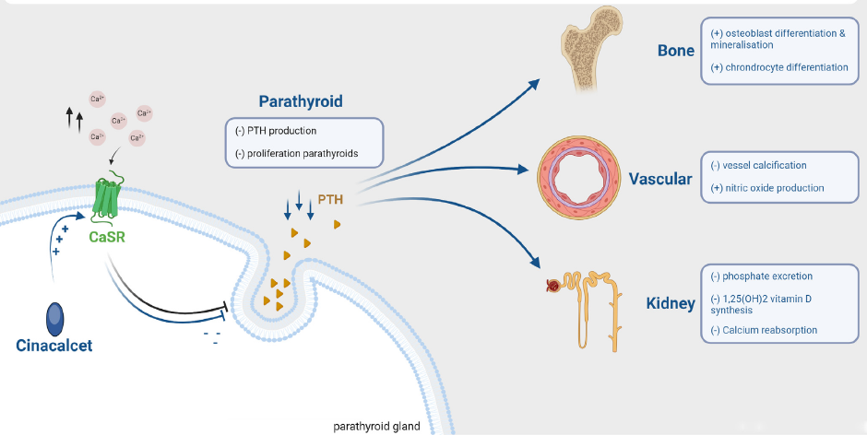
Calcimimetic: positive allosteric CaSR modulator
KI Reports (2024) 9, 2332–4

Slide 33
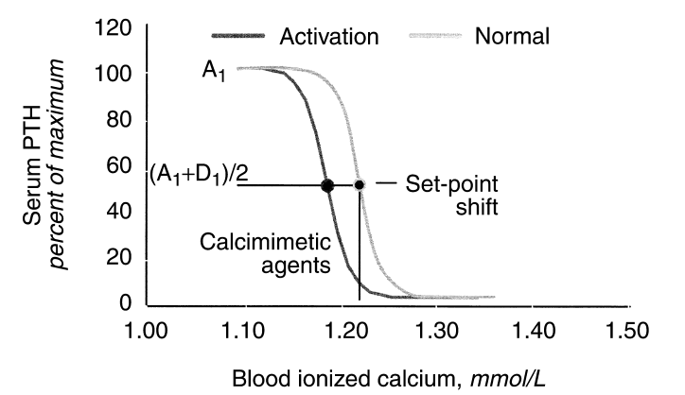
Calcimimetic: set point
KI 64, Supp 87 (2003), pp. S131–6

Slide 34
KDOGI 2017 : VDRA
PO₄ < 5.5 mg/dL and Ca < 9.5 mg/dL : Such patients are initially treated with calcitriol monotherapy.
Clinical Medicine 24 (2024)

Slide 35
KDOGI 2017: Calcimimetics
PO₄ > 5.4 mg/dL or Ca > 9.4 mg/dL : In patients with these elevated levels and persistently high PTH despite maximal phosphate-reducing therapy, cinacalcet initiation takes precedence over calcitriol or other synthetic analogs.
Clinical Medicine 24 (2024)

Slide 36
SHPT: Calcimimetics
Currently, calcimimetics are considered the first choice for SHPT in dialysis patients because they exert a strong inhibitory effect on PTH, leading to an effective reduction in parathyroid volume.
Very expensive: 193/tab (รพ รัฐ)
2024 Korean Endocrine Society

Slide 37
PO₄ Removal through Dialysis
In patients on conventional three-times-a-week, 4 h per session hemodialysis schedule, the amount of PO₄ removed is approximately 2.3–2.6 g, only half of the assumed dietary intake, if limited to 800 mg/day
Int. J. Mol. Sci. 2022

Slide 38
PO₄ Removal through HD
HD mode | PO₄ removal (mg/ครั้ง) | ระดับ PO₄ ลดลง (%)
Standard HD | 500-1200 | 30-50
High flux | 1000-1500 | 40-60
HDF | 1500 | 50-70
ChatGPT 4o
Notes:
However, standard 4-hour dialysis sessions 3 times per week have limitations in removing phosphate, typically eliminating around 900 mg of phosphate per session.

Slide 39
PTX (or thermal ablation): indications
Exacerbation of clinical signs and symptoms, such as intensified bone, joint or muscle pain
Onset of systemic complications, pathological fractures, calciphylaxis
Progression of laboratory abnormalities, such as persistent hyperCa or hyperPO₄ despite medication adherence
Clinical Medicine 24 (2024)

Slide 40
PTX: complications (1)
Postoperative Bleeding and Hematoma
Recurrent Laryngeal Nerve Injury
Hypoparathyroidism and Hypocalcemia
Persistent or Recurrent Hyperparathyroidism
NIH National Library of Medicine 2024

Slide 41
Hungry bone syndrome (HBS)
refers to the rapid, profound, and prolonged hypoCa associated with hypoPO₄ and hypoMg, and is exacerbated by suppressed PTH levels, which follows parathyroidectomy in patients with severe hyperPTH and preoperative high bone turnover.
European Journal of Endocrinology, 2013

Slide 42
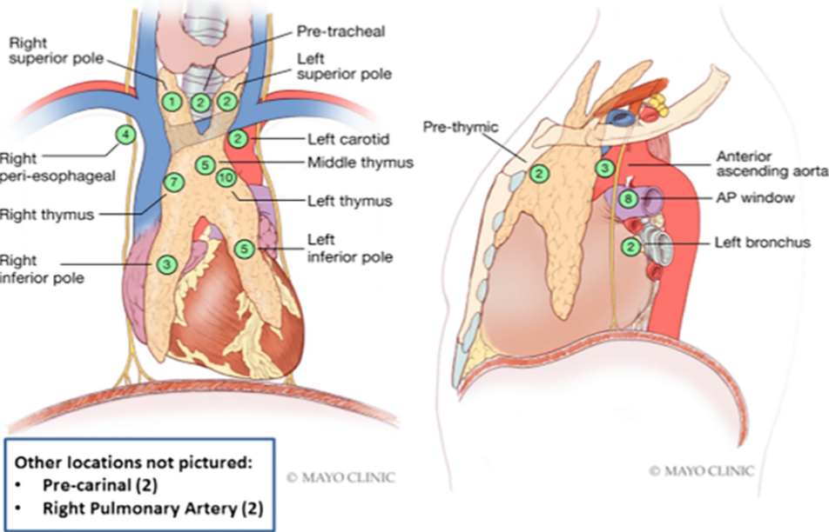
Parathyroid Glands: surgical location
Notes:
Parathyroid gland operative locations. Illustration of the various operative locations where the parathyroid glands were found throughout the mediastinum. The numbers in the green boxes represent the number of PTG found at each location. Fifty-nine patients had successful parathyroidectomies. One patient had 2 ectopic parathyroid glands excised; therefore, a total of 60 glands are represented in this image. AP, aortopulmonary

Slide 43
THANK YOU

