Slide 1
Synthetic Dialyzer Reaction:
พ. เจริญ เกียรติวัชรชัย
16 กค 2568: 16:00 น

Slide 2
เนื้อหา :
Definition of dialyzer reaction
Types of dialyzer reaction
Incidence of dialyzer reaction
Synthetic dialyzer reaction**

Slide 3
Definition of Dialyzer Reactions:
refer to all of the abnormal sequelae resulting from the interaction between blood constituents and HD-membrane
UpToDate 2024

Slide 4
Types of Reaction:
Daugirdas and Ing classified reactions into
  Type A reaction
  Type B reaction
Given the partial overlap in symptoms between type A and B reactions, the timing could not be the only differentiating feature
UpToDate 2024

Slide 5
Type A Reaction: summary
timing: usually begin in the first few minutes of HD, although the onset may be delayed for up to 30 min
symptoms : variable, even cardiorespiratory arrest
etiology : Ethylene oxide, AN69 + ACEi
treatment : stopping dialysis immediately without returning the blood to the patient.
UpToDate 2024

Slide 6
Type B Reaction: summary
timing & symptoms: not occur until 15-30 minutes into the treatment, and there is generally an improvement in symptoms with continuation of HD
etiology : Cellulose membrane
Rx & prevention : supportive, dialyzer reuse
UpToDate 2024

Slide 7
Type vs Type B Reaction:
two other important characteristics thatdistinguish these reactions from type A reactions
  Type B reactions typically begin within the first 15 to 30 minutes of the dialysis treatment
  There is generally an improvement in symptoms with continuation of the dialysis treatment
UpToDate 2024
Notes:
This protective effect is thought toresult from coating of the free hydroxyl groups by plasma proteins

Slide 8
Type A Reaction: criteria
Major | Minor
Reproducible episode in the consecutive session using the same type and dialyzer brand | Developing within 20 min from the beginning of the HD session
Urticaria Rhinorrhea tearing Abdominal cramps Itching | Dyspnea Burning/heat sensation on body and/or vascular access Angioedema
Kidney Blood Press Res 2019;44:907–914

Slide 9
Type A Reaction: diagnosis / possible
Diagnosis | Possible case
3 major criteria | 2 major criteria
2 major criteria and 1 minor criterion | 1 major criterion and 2 minor criteria
 | 3 minor criteria
Kidney Blood Press Res 2019;44:907–914

Slide 10
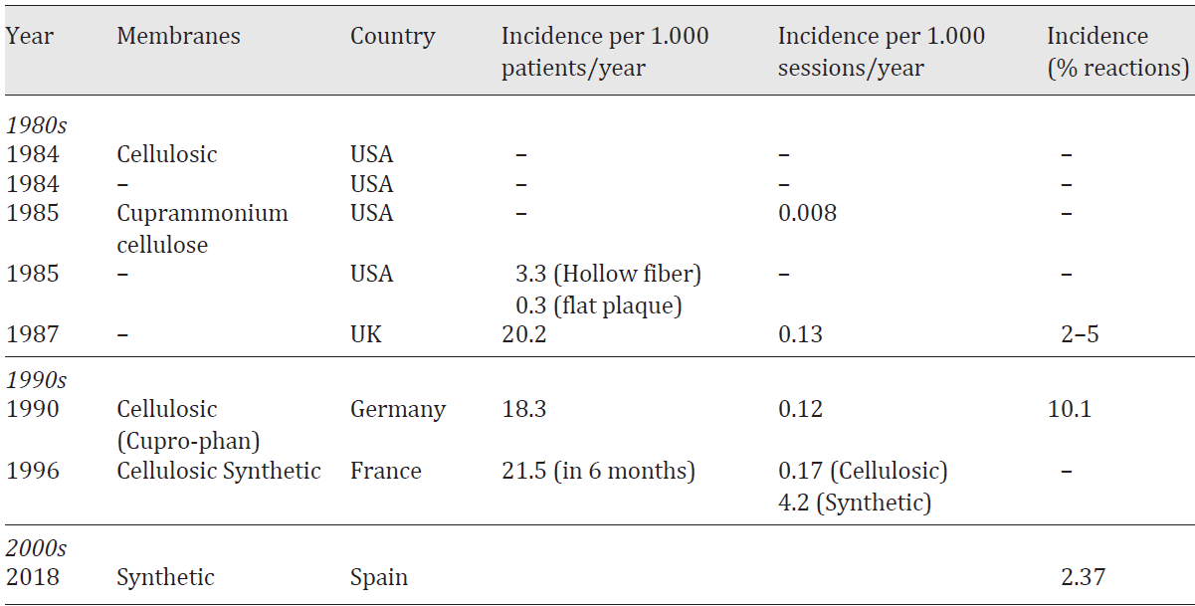
Incidence of Dialyzer Reactions
Kidney Blood Press Res 2019;44:907–914

Slide 11
Introduction :
Reactions were initially explained by ET bio-incompatibility -- > no problem anymore
In the last 20 years, changes have been made to PS to improve their performance, but their biocompatibility has worsened
Fecha actualización: 04/02/2021

Slide 12
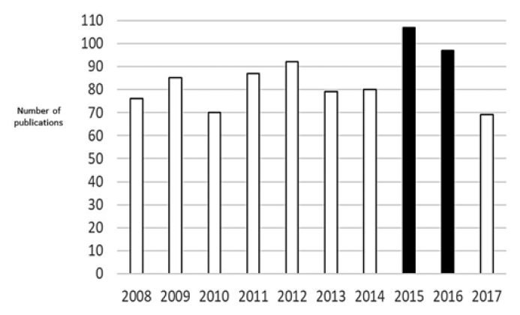
Number of references, 2018

Slide 13
Incidence of Hypersensitivity Reactions During HD
Retrospective multicenter observational study in adult dialysis units at 9 Spanish hospitals including all patients diagnosed with a dialysis membrane hypersensitivity reaction from August 2015 to August 2017
The case definition included a clinical diagnosis of symptoms
Only for 33 of 37 had the full dataset required to be evaluated
Kidney Blood Press Res (2018)

Slide 14
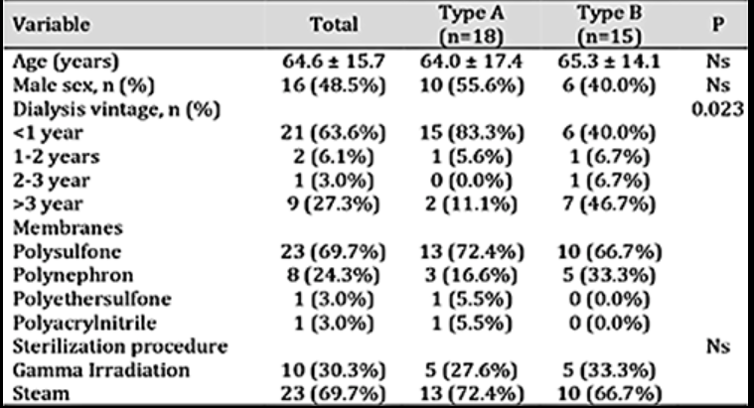
Results: demographic data
Kidney Blood Press Res (2018)

Slide 15
Types of Dialyzer Membrane:
PS - > 62.2%, polynephron - > 21%, PES - > 2.7% PAN - > 1 ราย
these results suggest that the use of more biocompatible synthetic membranes has not decreased the incidence of reactions and that, within synthetic membranes, not just PS are associated with this type of reaction.
Kidney Blood Press Res 2019;44:907–914

Slide 16
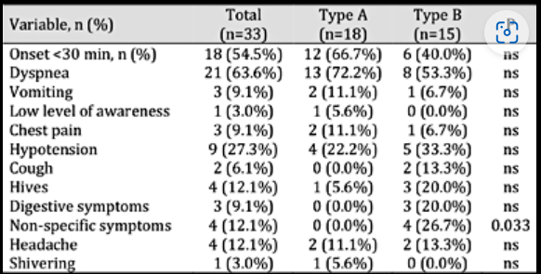
Results: clinical manifestations
Kidney Blood Press Res (2018)

Slide 17
Clinical Manifestation (1) :
type A or B reactions (18 vs. 15 cases).
no significant differences were found between the 2 types in
terms of symptoms described, composition of the membrane involved, method of sterilization, or timing
Kidney Blood Press Res 2019;44:907–914

Slide 18
Clinical Manifestation (2)
early or late, acute or subacute, serious or less severe
more to less frequent : dyspnea, hypotension, bronchospasm, cough, vomiting and other digestive symptoms, chest pain, pruritus, urticaria, fever, headache and confusion.
in the most severe cases : cardio-respiratory arrest and death
Fecha actualización: 04/02/2021

Slide 19
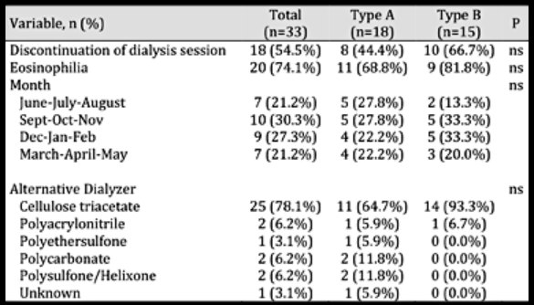
Results: others
Kidney Blood Press Res (2018)

Slide 20
Clinical Manifestation (3) :
This suggests that in clinical practice, HD-physicians are unable to recognize both types of reactions as separate clinical entities and questions the usefulness of the type A or B reaction categorization
In this regard, in all cases, replacement of the dialysis membrane by a different one, usually cellulose triacetate, was associated with the disappearance of symptoms.
Kidney Blood Press Res 2019;44:907–914

Slide 21
Timing of Synthetic Membrane Reaction
50% appears in 1st week of exposure to the causative dialyser. however, this interval may be extended up to 36 months.
2/3 of the cases, symptoms appear in the first 30 minutes of the HD, but can appear at any time during the session
Fecha actualización: 04/02/2021

Slide 22
Relations to Types of Membrane (1):
In some of the published cases, the patient had been dialysed with several of these membranes, presenting reactions associated with the use of synthetic membranes with all of them, with different symptoms.
when the patient went to dialysis with TAC, he/she had no further reactions
Fecha actualización: 04/02/2021

Slide 23
Relations to Types of Membrane (2):
the only common point is that symptoms disappear after replacing the synthetic membrane, by a cellulose membrane.
reports of symptoms disappearing following replacement by a different synthetic membrane without polyvinylpyrrolidone (PVP) or bisphenol A (BPA) or to similar membranes but produced through a different manufacturing process
Kidney Blood Press Res 2019;44:907–914
Notes:
Different types of PVP are added to polysulfone dialyzers and other synthetic membranes
as a hydrophilic pore-forming agent to improve permeability. PVP is attached to the dialyzer
membrane by strong cross-linked bonds, but not in all cases. Thus, both the previous washing
with saline and the stress of shearing the blood on contact with the membrane can release
PVP molecules that pass into the patient’s blood. The subsequent elimination of this compound
and, above all, of its soluble derivatives, is not very clear [25, 26]. Some studies [24] seem to
show that PVP is not responsible for these reactions, as there is no correlation with the prick
test on skin. However, it could happen that some PVP-derived soluble compound detached
from the dialyzer membrane may be a causal agent in these reactions, since the most modern
PVP-free membranes do not generally cause hypersensitivity reactions. New membranes
without PVP or with structural modifications that decrease platelet aggregation and subsequent
inflammation are presented as a promising alternative in the near future [27, 28].

Slide 24
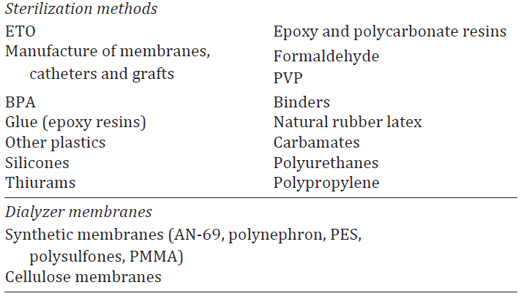
Potential causes of hypersensitivity reactions (1)
Kidney Blood Press Res 2019;44:907–914

Slide 25
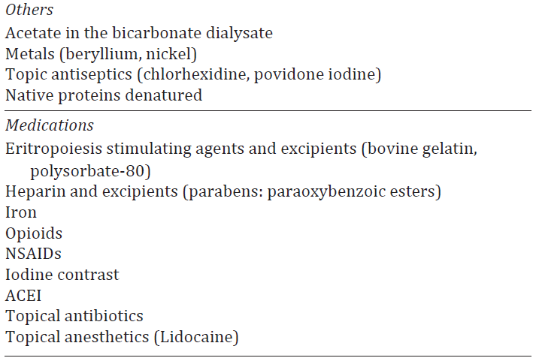
Potential causes of hypersensitivity reactions (2)
Kidney Blood Press Res 2019;44:907–914

Slide 26
Drivers of Reaction : PVP
All membranes with reaction have in common that they contain polyvinylpyrrolidone (PVP).
PVP is incorporated into the hydrophobic membrane to create hydrophilic spaces and improve hydraulic permeability.
the most modern PVP-free membranes do not generally cause hypersensitivity reactions
Fecha actualización: 04/02/2021

Slide 27
High Suspicious in
should be suspected in patients on dialysis with synthetic dialysers and with acute or chronic intra-dialysis symptoms, not explained by other causes.
eosinophilia, increased serum tryptase, or hypocomplementemia help the differential diagnosis.
Fecha actualización: 04/02/2021

Slide 28
Treatment
acute and severe symptoms should be treated by stopping the blood pump and disconnecting the lines without bl-returning.
symptomatic treatment should be started: O₂, iv steroids, antihistamines, and bronchodilators as appropriate.
If the patient stabilizes, dialysis could be restarted by switching to a TAC dialyzer.
Fecha actualización: 04/02/2021

Slide 29
THANK YOU

