Slide 1
HD-Vascular Access (VA) Complications-EP 1:
Basic -- > VA Failure
พ. เจริญ เกียรติวัชรชัย
16 มิย 2568: 16:00 น
Notes:
Vascular access = AV vascular access + central venous catheter
AV vascular access = AVF + AVG

Slide 2
เนื้อหา :
Vascular access (VA) in HD : basic
  type & location of VA
  VA anastomosis
  AVF maturation
Complications : VA Failure or Dysfunction

Slide 3
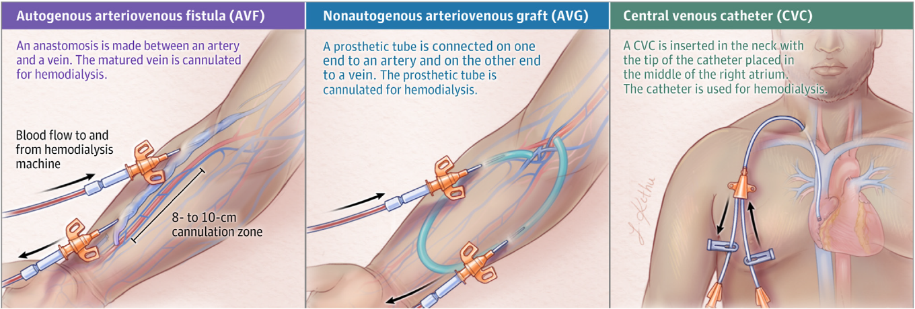
HD-VA : 3 types
First choice** Second choice* Last choice
Arteriovenous VA
Notes:
Autogenous AVF = เชื่อมต่อ artery-vein ที่อยู่ในบริเวณเดียวกันโดยตรง
Autologous vascular graft = ใช้เส้นเลือดจากส่วนอื่นของร่างกายเดียวกันมาเป็น conduit เชื่อมต่อ artery กับ veinดังนั้น การเอาเส้นเลือดจากขามาใช้ที่แขน จะเป็น "autologous" เพราะเป็นการย้าย tissue จากส่วนหนึ่งไปอีกส่วนหนึ่งของร่างกายเดียวกัน

Slide 4
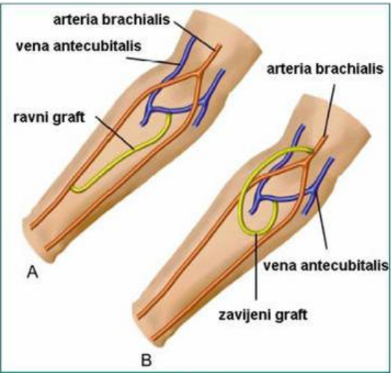
Arterio-Venous Graft (AVG)
straight grafts*
loop grafts**

Slide 5
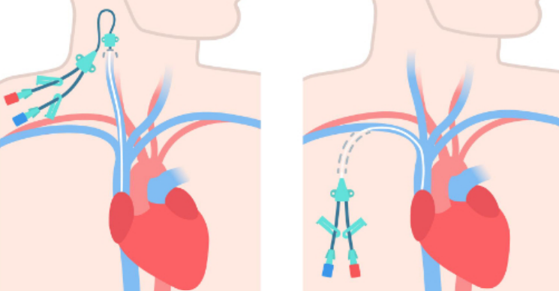
Central Venous Catheter
Non-Tunneled
Tunneled Catheters*

Slide 6
Central Venous Catheter :
Non-tunneled “temporary” CVC should only be in place for 2 weeks to reduce the risk of catheter-related infection
The key complications with CVC use include CVC dysfunction, CVC-related infections, and central venous stenosis

Slide 7
AVF vs AVG
 | AVF | AVG
อายุการใช้งาน | 5-10 ปี หรือมากกว่า | 2-5 ปี
ความเสี่ยง Thrombosis | 5-10% | 20-30%
ความเสี่ยง Stenosis | ต่ำ | สูง
ความเสี่ยงติดเชื้อ | ต่ำมาก (<1%) | ต่ำ (2-5%)
ภาวะแทรกซ้อนเฉพาะ | Steal syndrome High output HF Aneurysm formation | Seroma Graft infection Pseudoaneurysm

Slide 8
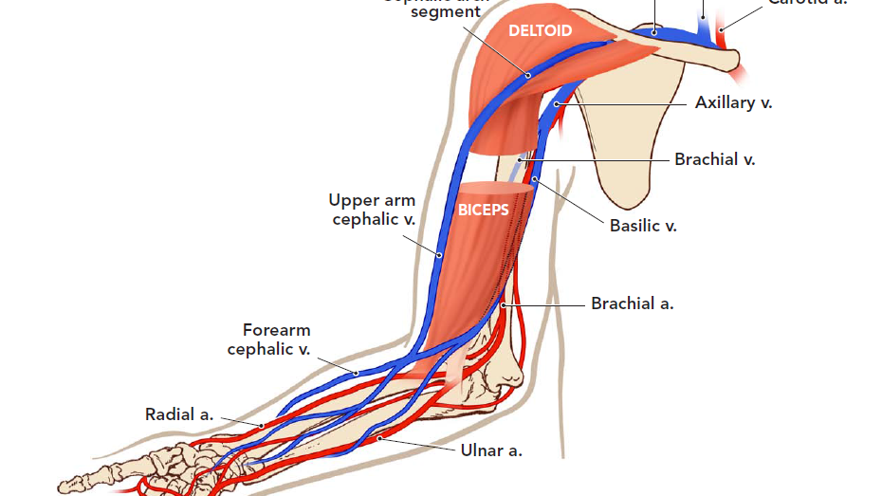
Anatomy of Upper Extremity Vessels

Slide 9
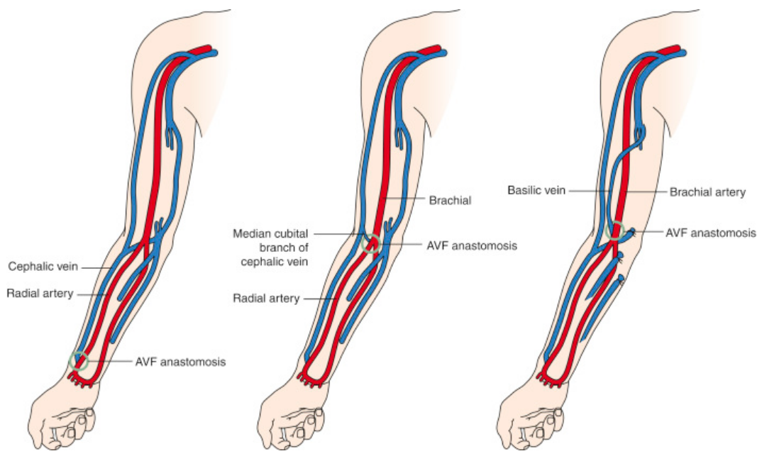
AVF (AVG) : location
Radio-cephalic**
Brachio-cephalic*
Brachio-basilic
Notes:
Radio-cephalic fistulas have higher rates of long-term
patency than those at other sites

Slide 10
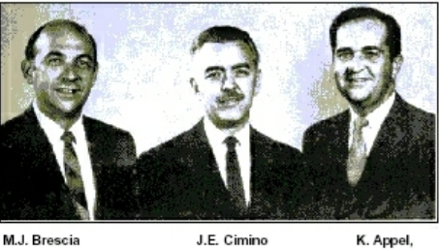
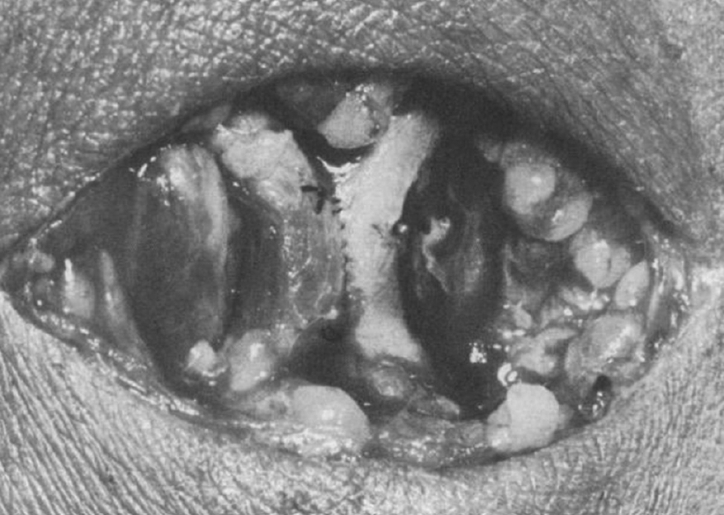
Radio-cephalic AVF (Brescia-Cimino Fistula)
ข้อดี : | ข้อเสีย :
สามารถทำ AVF ในตำแหน่งอื่นได้ในอนาคตหากจำเป็น** | primary failure สูงกว่า**
higher rates of long-term patency than other sites | BFR ต่ำกว่า
ภาวะ steal syndrome พบได้น้อย
ภาวะ venous HT พบได้น้อย
Notes:
เบรชา-ชิมิโน ฟิสทูล่า
1966 ตีพิมพ์ใน NEJM
Dr. Michael J. Brescia และ Dr. James E. Cimino เป็นผู้นำหลักในการพัฒนาเทคนิคนี้ จึงมี AVF ชื่อตามนามสกุลของทั้งสองท่าน โดย Dr. Brescia เป็น nephrologist และ Dr. Cimino เป็น vascular surgeon ที่ร่วมกันคิดค้นเทคนิคการสร้าง arteriovenous anastomosis ที่ข้อมือ (radiocephalic fistula)

Slide 11
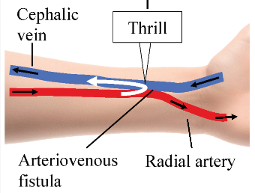
VA-associated Steal Syndrome
Inadequate art Inflow
High distal artery resistance*
Low venous outflow resistance*
2
3
1

Slide 12
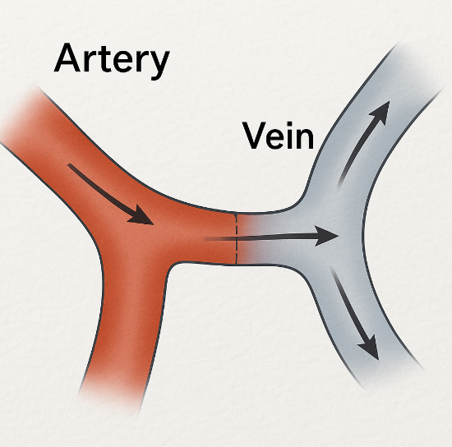
RCF : Artery End → Vein Side
อัตรา maturation สูง และ patency ดีในระยะยาว
ให้ flow rate ที่ดี
ลดโอกาสเกิด steal syndrome

Slide 13
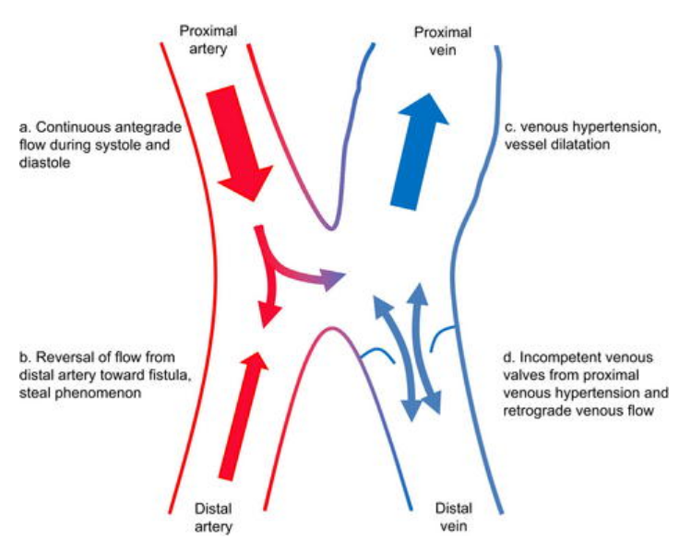
Venous Hypertension
if the outflow veins are not adequately with the increased flow, often due to stenosis or valve problems

Slide 14
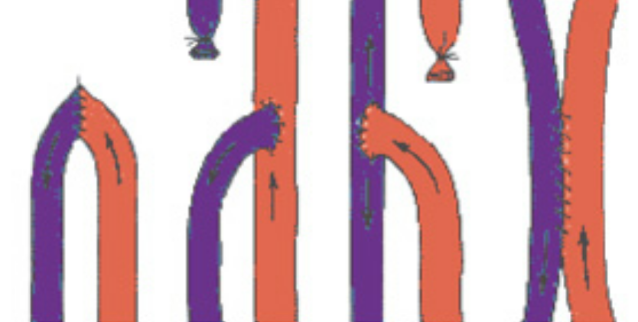
AVF : anastomosis
end-art to end vein anastomosis
side-art to end-vein*
end-art to side-vein***
side-art to side-vein
A B C D

Slide 15
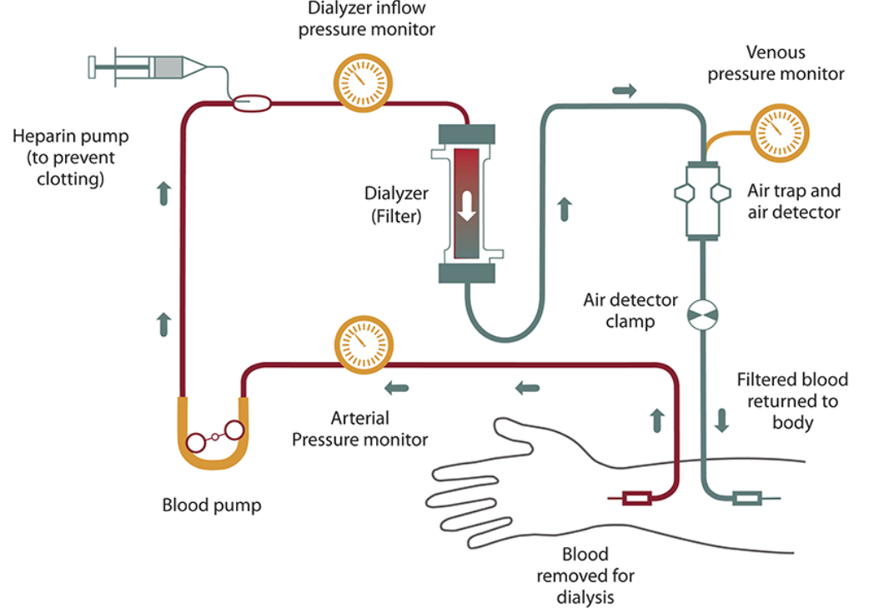
Arterio-Venous VA : arterial & venous lines
Venous line
Arterial line

Slide 16
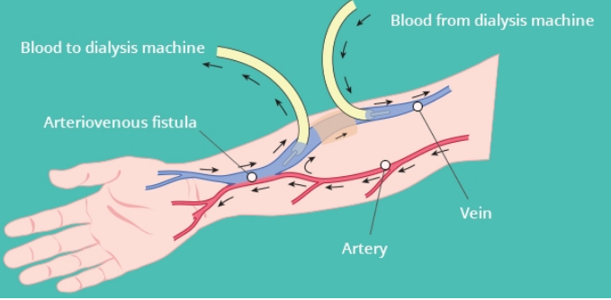
VA Flow : arterial & venous lines
Arterial BF
Venous line
Arterial line
Access BF
Notes:
mean blood flow in the radial artery, only 40-64 ml/min before fistula creation, can increase ten-fold to achieve maturation
mean blood flow in the brachial artery, about 220 ml/min at baseline, often increases to over 1000 ml/min in a mature upper arm fistula.

Slide 17
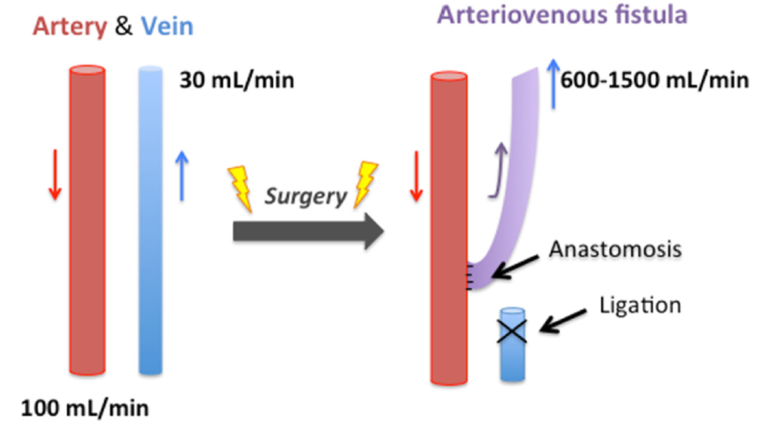
AVF-Blood Flow: before vs after
(20-50 เท่า) ****
Access BF
Radial art: 20.1 ---> 174 ml / min in 10 min
Notes:
BF in vein เพิ่ม 20-150 เท่า
Won et al. found significant increase in BF from average 20.1 mL/min in the radial artery average 174 mL/min in the fistula only ten minutes after creation of anastomosis
Major changes in the fistula BF and size occurred within four weeks after fistula construction
No significant changes in this two parameters were noted in the second, third or fourth month after fistula creation

Slide 18
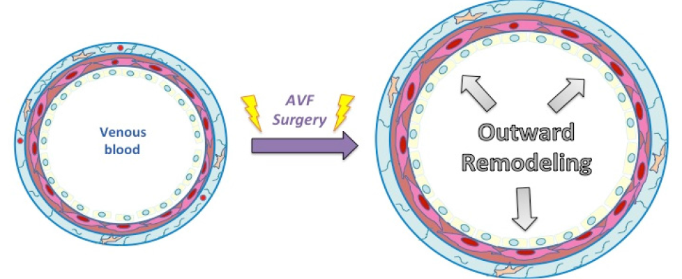
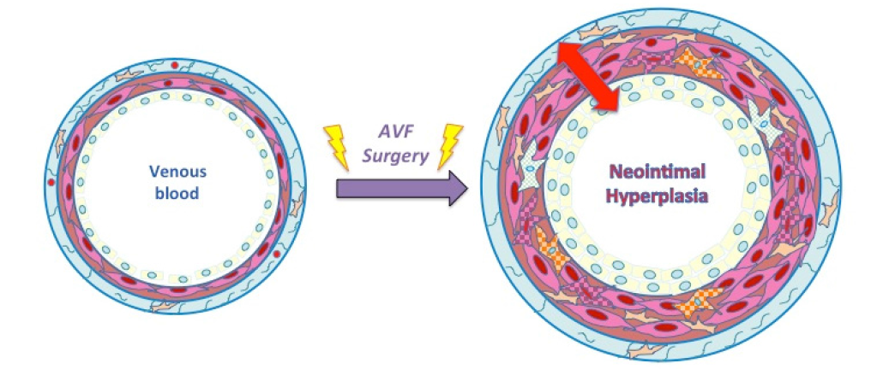
Maturation : Vein--> Arterialization

Slide 19
AV Fistula Maturation
rate of unassisted maturation 30%-70%
one of the most important determinants of AVF maturation is the ability of the inflow artery and outflow vein that occurs upon anastomosis of the artery and vein
3
2
1

Slide 20
ความสำคัญของการ mature เต็มที่ :
ลด complications (thrombosis, stenosis)
ใช้งานได้นานกว่า (longevity)
Kt/V ดีกว่า
ลดปัญหาการเข็มหลุด

Slide 21
AVF Maturation : definition base on
anatomical changes (size and flow)*,
the ability to cannulate the fistula for HD, and
interventions were required to promote maturation of the fistula
Canadian Journal of Kidney Health and Disease 2016

Slide 22
AVF Maturation (or adequate) : definition
AVF as being at ≥ 6 mm in diameter, < 6 mm deep, and with a BF ≥ 600 mL/min
AVFs should allow using two needles, have adequate BF, and have minimal recirculation.

Slide 23
AVF Maturation : the rule of 6’s
diameter of at least 0.6 cm.
flow of at least 600 mL/min
depth less than 0.6 cm below the surface
at 6 weeks post creation
length of 6 cm
KDOGI 2006
Notes:
In 2018, the Hemodialysis Fistula Maturation study defined clinical maturation as AVF use for 75% of treatments over 4 weeks with adequate blood flow and clearance
the 2019 update to the KDOQI guidelines did not confirm that statement, suggesting that AVF maturation should be based on clinical judgment.

Slide 24
AVF Maturation : definition
The clinical maturation criteria can be satisfied at any time within 9 months of fistula creation surgery or within 8 weeks of dialysis therapy initiation, whichever comes later
; ถ้าผ่าตัดสร้าง fistula 1 มค และเริ่ม HD 1 มีนาคม → เกณฑ์ maturation จะนับจากวันที่ 1 มค + 9 เดือน = 1 ตุลาคม (เพราะ 8 สัปดาห์จากวันเริ่ม HD จะสิ้นสุดเร็วกว่า)
Canadian Journal of Kidney Health and Disease 2016

Slide 25
AVF Maturation : Primary Mechanisms
Hemodynamic Changes
Venous Dilatation
Vascular Wall Remodeling
Claude 2025

Slide 26
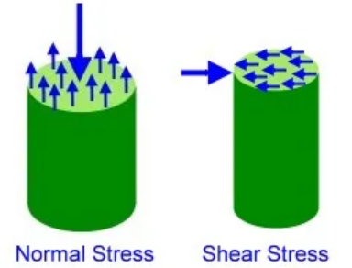
AVF Maturation : Cellular and Molecular Mechanisms (1)
Shear Stress Response Increased wall shear stress triggers endothelial cell activation, leading to:
  Nitric oxide production
  Endothelin-1 release
  Growth factor expression (VEGF, PDGF)
  Matrix metalloproteinase activation
Claude 2025

Slide 27
AVF Maturation : Cellular and Molecular Mechanisms (2)
Inflammatory Response
  Nitric oxide production
  Macrophage infiltration
  Cytokine release (TNF-α, IL-1β, IL-6)
  Complement activation
  Tissue repair mechanisms
Claude 2025

Slide 28
AVF Maturation : Factors Affecting Maturation (1)
Patient Factors
  Age (elderly patients mature slower)
  DM (impaired angiogenesis)
  Cardiovascular disease
  Nutritional status
  Immunosuppressive medications
  Peripheral arterial disease
Claude 2025

Slide 29
AVF Maturation : Factors Affecting Maturation (2)
Technical Factors
  Vessel quality and size
  Anastomotic technique
  Location of AVF creation
  Surgical experience
Claude 2025

Slide 30
AVF Maturation : Factors Affecting Maturation (3)
Hemodynamic Factors
  Adequate arterial inflow
  Unobstructed venous outflow
  Appropriate flow rates
  Pressure gradients
Claude 2025

Slide 31
Maturation Failure : predictors
the most relevant predictor of AVF maturation was preoperative arterial diameter, not venous diameter.
patient age greater than or equal to 65 years,
peripheral vascular disease,
coronary artery disease,
race etc

Slide 32

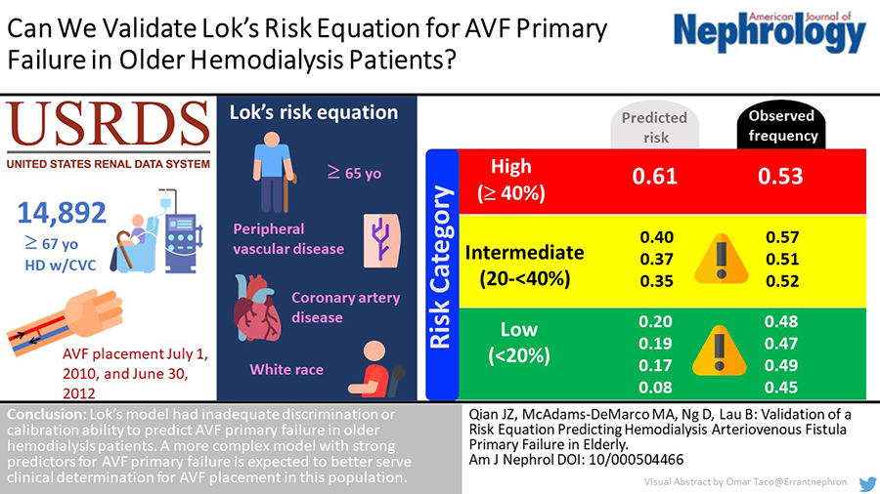
From: Validation of a Risk Equation Predicting Hemodialysis Arteriovenous Fistula Primary Failure in Elderly
Am J Nephrol. 2019;51(1):17-23. doi:10.1159/000504466
Date of Download: 6/15/2025
Copyright © 2025 Karger Publishers. All rights reserved.
Notes:
Figure Legend:

Slide 33
AVF Failure : Primary failure
def: created fistulas which never become suitable for dialysis
the median time to the first use was 108 days
39% failed to mature sufficiently for use in dialysis
The Journal of Vascular Access 2021

Slide 34
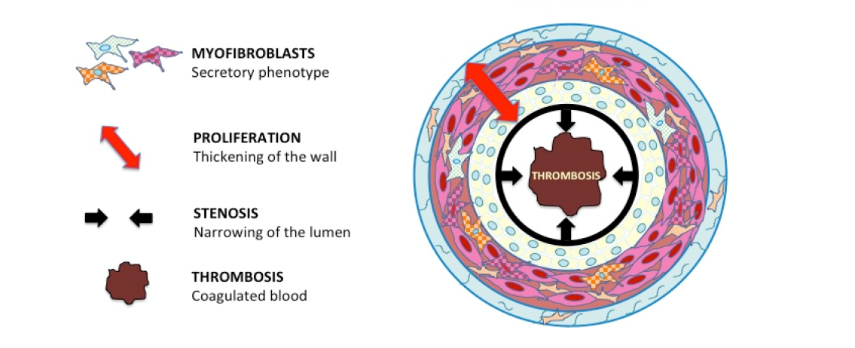
AVF Mature Failure

Slide 35
AVG Failure
The primary failure rate for grafts is less than that for fistulas.
The primary patency rate for grafts is less than that for fistulas.

Slide 36
AVF Failure : secondary failure
Def: fistulas which mature successfully and are used for dialysis for some length of time but later become dysfunctional
primary patency rates of AVFs were 60, 51 % at 1, 2 year
secondary patency rates of AVF were 71, 64% at 1,2 year

Slide 37
AVF Maturation Failure : definition
There are no universal definitions
A commonly used, simple, and practical definition of primary failure as the inability to use a fistula for dialysis within 3 months of its creation
The Journal of Vascular Access 2021

Slide 38
Primary fistula failure : causes
stenosis (90%) ; juxta-anastomotic stenosis has been implicated in as many as 64%
arterial stenosis, central venous stenosis, and the presence of collateral veins
The Journal of Vascular Access 2021
Notes:
Juxtaanastomosis; vein within the first 4 cm from the arterial anastomosis
Arterial anastomotic
and venous swing point stenoses are commonly seen
acquired lesions as these are the sites of surgical creation
and mobilization of the artery and vein

Slide 39
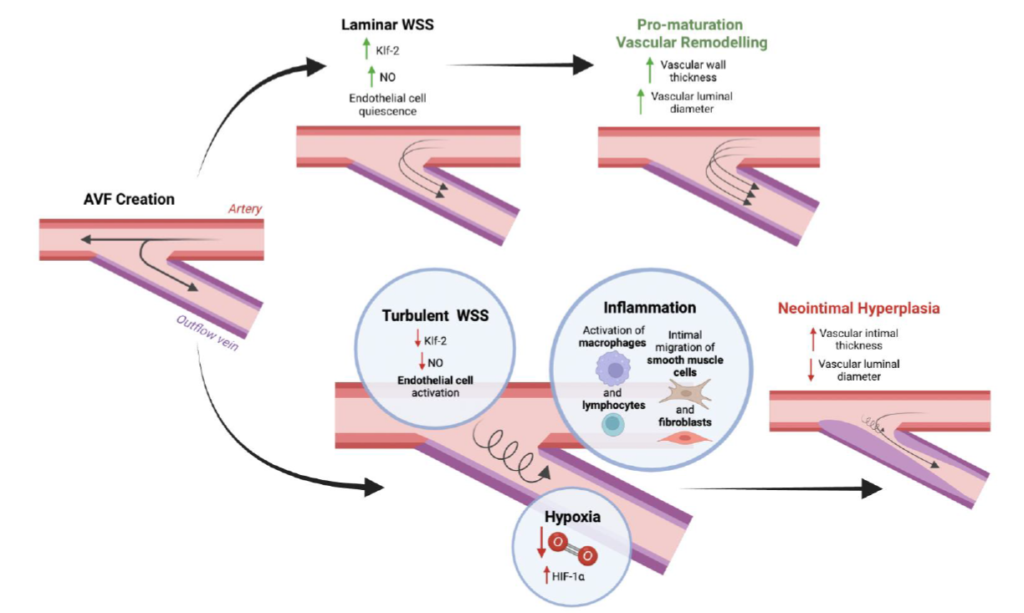
Pathways that lead to AVF Maturation vs Failure

Slide 40
Secondary fistula failure : causes
Venous lesions are responsible nearly all
99% of stenotic lesions detected were venous
Juxta-anastomotic stenosis is the most common cause
The Journal of Vascular Access 2021
Notes:
Venous outflow lesions are the most common lesions
found in fistulae that fail to mature. Venous outflow
lesions, including the central veins, may be due to
preexisting anomalies, such as anatomically small veins,
fibrotic or stenotic veins, or sites of prior puncture or
catheter placement

Slide 41
Detection of Fistula Failure
Absence or brevity of a thrill
A pulsatile fistula
Failure of the AVF to collapse when elevated above the level of the heart : Hand Elevation Test
Failure of the AVF pulse to augment with occlusion of the venous limb : Compression Test
Prolonged bleeding
The Journal of Vascular Access 2021

Slide 42
Maturation Failure : early detection
early intervention to identify and salvage immature fistula becomes an important part of preventing
fistula loss and minimizing complications related to dialysis catheters

Slide 43
Maturation Failure : prevention
health care process or team interventions
medical interventions (currently no proven pharmacologic therapies to prevent primary failure)
endovascular or surgical manipulations
device intervention
Canadian Journal of Kidney Health and Disease 2016
Notes:
Infrared therapy may upregulate nitric oxide synthesis and result in improved endothelial function and subsequent vascular dilation leading to improved fistula maturation

Slide 44
Pre-operative vessel mapping
Doppler ultrasound
Venography: prior CV Catheter insersion
A widely used threshold for determining appropriate vascular anatomy is a venous luminal diameter of 2.5 mm and an arterial inflow diameter of 2 mm
The Journal of Vascular Access 2021
Notes:
Further complicating
the issue is that despite selection of the best available
artery and vein, fistula maturation rates have not
changed

Slide 45
การป้องกัน VA Dysfunction
Surveillance & Monitoring
Pharmacological Interventions : aspirin ?, infrared
Risk Factor Management : ควบคุมความดันโลหิต, exercise
Technical Care
  เทคนิคการเจาะ; การหมุนตำแหน่งเจาะ, ใช้เข็มขนาดเหมาะสม
  การควบคุมความดัน

Slide 46
Current Clinical Strategies to Prevent AVF Failure
There are also no recommended pharmacologic agents for preventing AVF failure
Although several investigational therapies have aimed at suppressing NIH, none has shown a clear benefit towards improving AVF patency outcomes
Biomolecules 2022

Slide 47
Other AVF Complications :
early : non-functional AVF, complete patency loss in the first three or six months of creation
late : true and false aneurysms, venous stenosis at anastomosis or AVF puncture sites, collateral circulation
Acta Angiol 2017

Slide 48
THANK YOU

